Slide 1

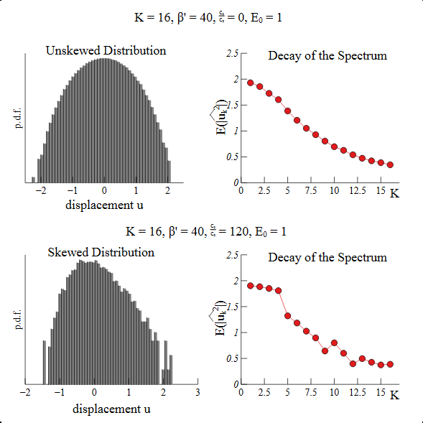
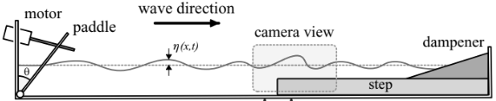
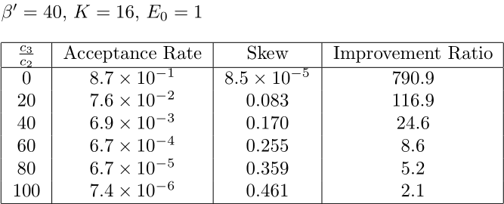
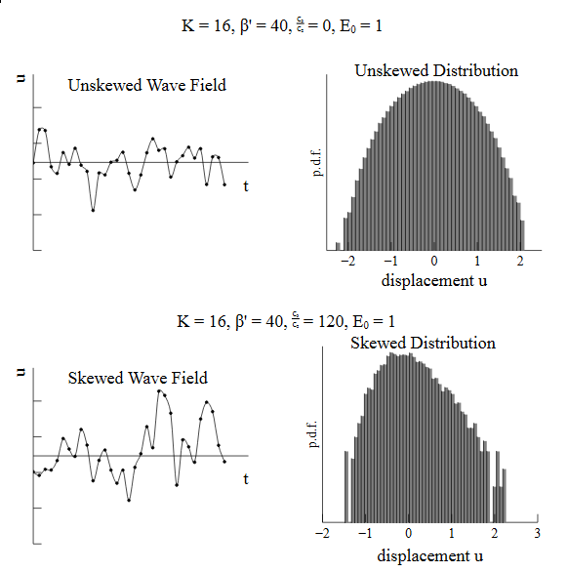
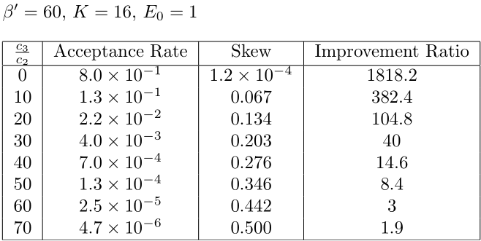
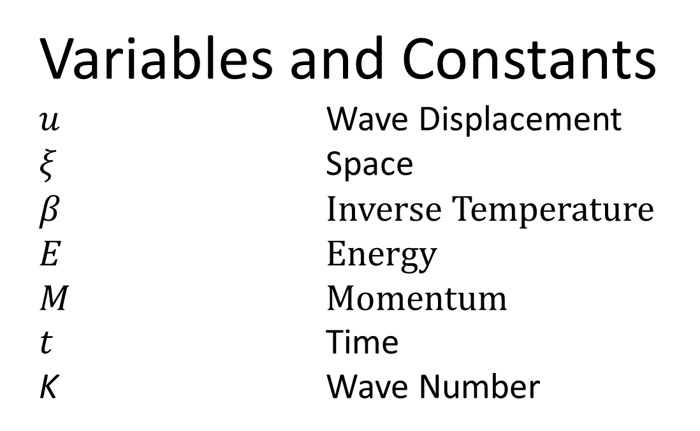

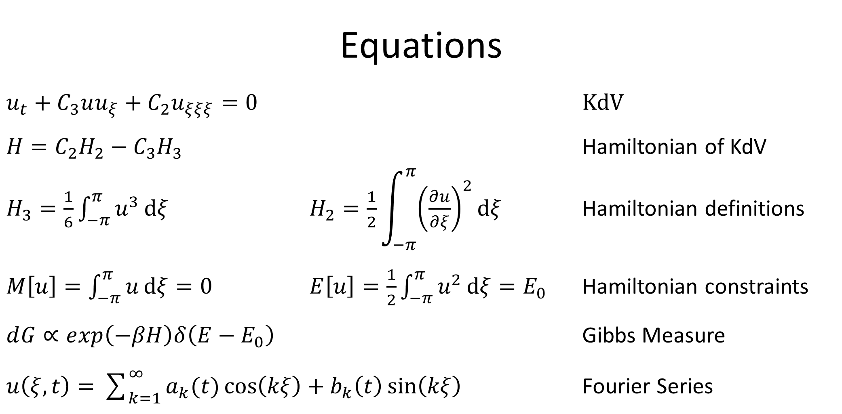
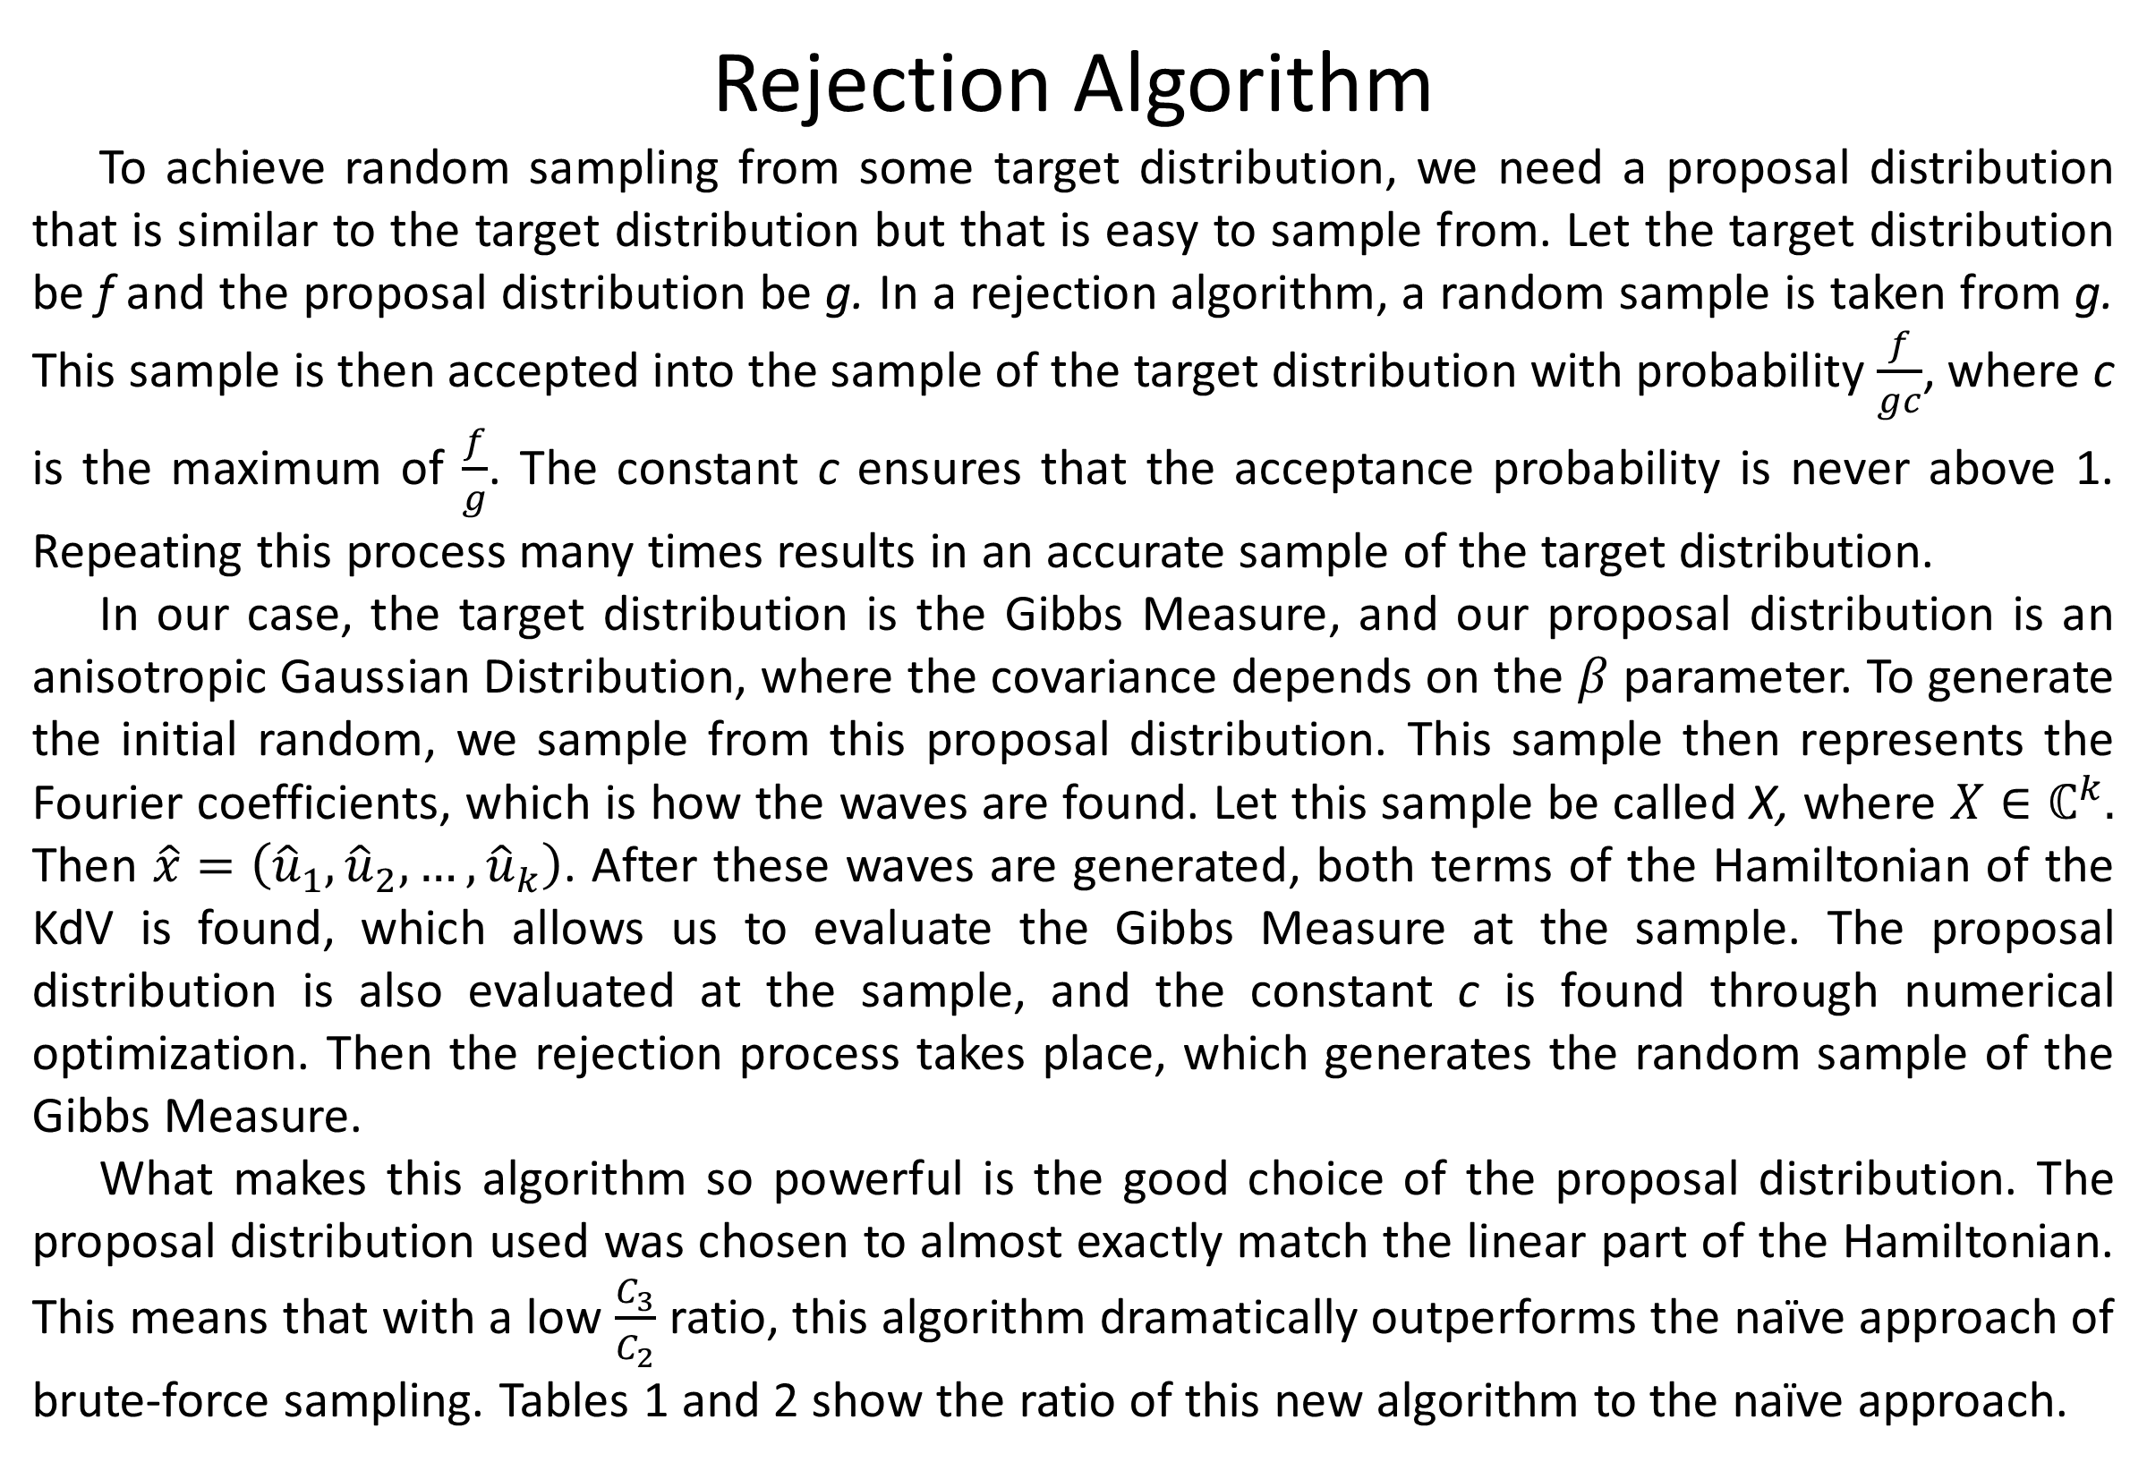

Sampling Algorithms for Rogue Waves Triggered by Depth Changes
Brendan Foerster
Abstract
Rogue waves are a phenomenon that have intrigued and confounded oceanographers for generations. These waves, which can be defined as a wave four standard deviations above the average surface displacement, are difficult to model, because they do not follow a normal distribution. Rather, they can be modeled by a high-dimensional distribution called the Gibbs Measure. The Gibbs Measure is derived from the Korteweg-De Vries (KdV) differential equation that models the movement of waves. This distribution is difficult to sample from, so it would be useful to implement a general algorithm that could draw a random sample from this distribution given certain parameters. This could be achieved through a process called rejection sampling. Rejection sampling allows one to draw a random sample from an initial proposal distribution with certain parameters and accept it if it fits the Gibbs Measure or reject it if not. The parameters of this distribution are determined from the initial conditions around the wave. Repeating this process many times will result in a large sample of the Gibbs Measure with the given parameters.
Numerical Results
Fig. 4
These plots show the effect of raising the $\frac{C_{3}}{C_{2}}$ ratio on the skewness of the wave displacement distribution and the decay of the spectrum.
Table 1
This Table shows the acceptance rate of the rejection algorithm with a varied $\frac{C_{3}}{C_{2}}$ ratio. It also shows the skew of the accepted sample, and the Improvement ratio to demonstrate the effectiveness of this proposal distribution compared to the naïve proposal distribution.
Table 2
Fig. 3
A picture of what a rogue wave could look like in comparison with a ship (Getty Images).
Generating Rogue Waves Experimentally
Fig. 1
Experimental setup for generating rogue waves from Bolles et. al. (2019).
The camera view highlighted is a side view of the waves, which can also be seen in the wave field plots.
Equations
$u_{t}+C_{3}uu_{ξ}+C_{2}u_{ξξξ}=0$ KdV
$H=C_{2}H_{2}−$ $C_{3}H_{3}$ Hamiltonian of KdV
$H_{3}=\frac{1}{6}\int_{−π}^{π}{u^{3}ⅆξ}$ $H_{2}=\frac{1}{2}\int_{−π}^{π}{{\left(\frac{∂u}{∂ξ}\right)}^{2}ⅆξ}$ Hamiltonian definitions
$M\left[u\right]=\int_{−π}^{π}{uⅆξ}=0$ $E\left[u\right]=\frac{1}{2}\int_{−π}^{π}{u^{2}ⅆξ}=E_{0}$ Hamiltonian constraints
$ⅆG∝ⅇxp\left(−βH\right)δ\left(E−E_{0}\right)$ Gibbs Measure
$u\left(ξ,t\right)=\sum_{k=1}^{∞}{a_{k}(t)\cos\left(kξ\right)}+b_{k}\left(t\right)\sin\left(kξ\right)$ Fourier Series
Variables and Constants
$u$ Wave Displacement
$ξ$ Space
$β$ Inverse Temperature
$E$ Energy
$M$ Momentum
$t$ Time
K Wave Number
Wave Fields
Fig. 2
When $\frac{C_{3}}{C_{2}}$ is close to 0, the displacement of waves follows a normal distribution. When this ratio gets large, the distribution becomes skewed, which leads to the appearance of rogue waves.
Rejection Algorithm
To achieve random sampling from some target distribution, we need a proposal distribution that is similar to the target distribution but that is easy to sample from. Let the target distribution be f and the proposal distribution be g. In a rejection algorithm, a random sample is taken from g. This sample is then accepted into the sample of the target distribution with probability $\frac{f}{gc}$, where c is the maximum of $\frac{f}{g}$. The constant c ensures that the acceptance probability is never above 1. Repeating this process many times results in an accurate sample of the target distribution.
In our case, the target distribution is the Gibbs Measure, and our proposal distribution is an anisotropic Gaussian Distribution, where the covariance depends on the $β$ parameter. To generate the initial random, we sample from this proposal distribution. This sample then represents the Fourier coefficients, which is how the waves are found. Let this sample be called X, where $X∈ℂ^{k}.$ Then $\hat{x}=\left({\hat{u}}_{1},{\hat{u}}_{2},…,{\hat{u}}_{k}\right)$. After these waves are generated, both terms of the Hamiltonian of the KdV is found, which allows us to evaluate the Gibbs Measure at the sample. The proposal distribution is also evaluated at the sample, and the constant c is found through numerical optimization. Then the rejection process takes place, which generates the random sample of the Gibbs Measure.
What makes this algorithm so powerful is the good choice of the proposal distribution. The proposal distribution used was chosen to almost exactly match the linear part of the Hamiltonian. This means that with a low $\frac{C_{3}}{C_{2}}$ ratio, this algorithm dramatically outperforms the naïve approach of brute-force sampling. Tables 1 and 2 show the ratio of this new algorithm to the naïve approach.
References
Bolles, C. Tyler and Speer, Kevin and Moore, M. N. J. “Anomalous wave statistics induced by abrupt depth change.” Phys. Rev. Fluids 4, no. 1 (January 2019). https://doi.org/ 10.1103/PhysRevFluids.4.011801
Moore, N.J., Bolles, C.T., Majda, A.J. et al. Anomalous Waves Triggered by Abrupt Depth Changes: Laboratory Experiments and Truncated KdV Statistical Mechanics. J Nonlinear Sci 30, 3235–3263 (2020). https://doi.org/10.1007/s00332-020-09649-2
Rogue Waves Have the Power to Sink Freighters 2023, Getty Images.https://www.mentalfloss.com/
posts/rogue-wave-facts
Sun, H., Moore, N.J. On Normal and Non-Normal Wave Statistics Implied by a Canonical– Microcanonical Gibbs Ensemble of the Truncated KdV System. J Stat Phys 190, 4 (2023). https://doi.org/10.1007/s10955-022-02999-z

